Slide 1
Chicago’s Crime
Analysis
Presented by Vincent Kong

Slide 2
Introduction
Chicago is one of the most dangerous cities in the United States, ranking 31th in the list provided by CBC news. In this project, we briefly apply crime analysis on the dataset provided.

Slide 3
Agenda
01
Dataset Description
02
Problem Statement
03
Data Cleaning
04
Method & Result
05
Conclusion

Slide 4
Data Description
From: | DATA.GOV
When: | From 2001 to present, minus the most recent seven day
Size : | 1.81 GB, column number: 22 , Row number: 7684983
Author: | Data is extracted from the Chicago Police Department's CLEAR (Citizen Law Enforcement Analysis and Reporting) system
Link: | https://catalog.data.gov/dataset/crimes-2001-to-present
About Dataset
Problem
Process
Method & Result
Conclusion

Slide 5
Why is it Big Data？
Volume
Variety
Velocity
Veracity
Str, Int,
Boolean,
Timestamp
Traditional tools can’t handle
Collected by governmental agencies
1.82 GB
7M+ Rows
Tableau
PySpark
Hive+Impala
About Dataset
Problem
Process
Method & Result
Conclusion

Slide 6
Problem Statement
How does the distribution of crimes in Chicago look like? By years, by types, by districts or community areas?
Some deeper key statistics, such as arrest rates? What does it indicate? Based on the results, any suggestion or recommendation for us?
About Dataset
Problem
Process
Method & Result
Conclusion

Slide 7
Data Cleaning
Drop columns that we certainly didn’t need
22 Columns —> 11 Columns
Drop Na values
7684983 rows —> 6992709 rows
Replace True and False to Dummy values 1 and 0
Replace spaces in column names to underscore
Separate time, date, year, Daytime, Nighttime
Size reduced from 1.81GB to 625MB
Why do we care?
Columns Dropped: Beat, Ward, IUCR, FBI Code, Domestic, Description, Y Coordinate, X Coordinate, Updated On, Location, Block
About Dataset
Problem
Process
Method & Result
Conclusion

Slide 8
Data Processing
Methods we used
Python (Data Cleaning)
Pandas (Data Cleaning)
PySpark (Data Processing and Analyzing)
Impala / Hive (Data Processing and Analyzing)
Tableau (Data Visualization)
HDFS (Data Storagement and Transfering)
About Dataset
Problem
Process
Method & Result
Conclusion

Slide 9
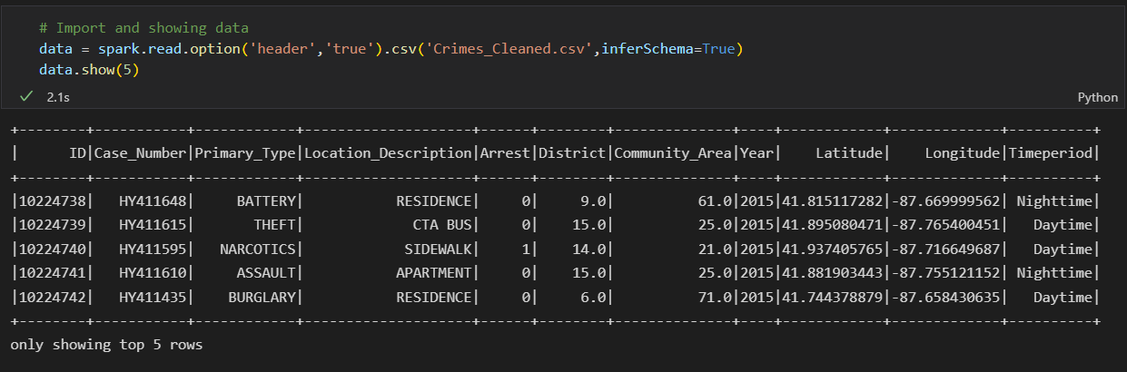
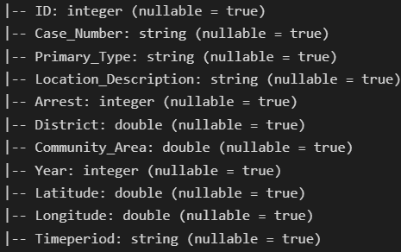
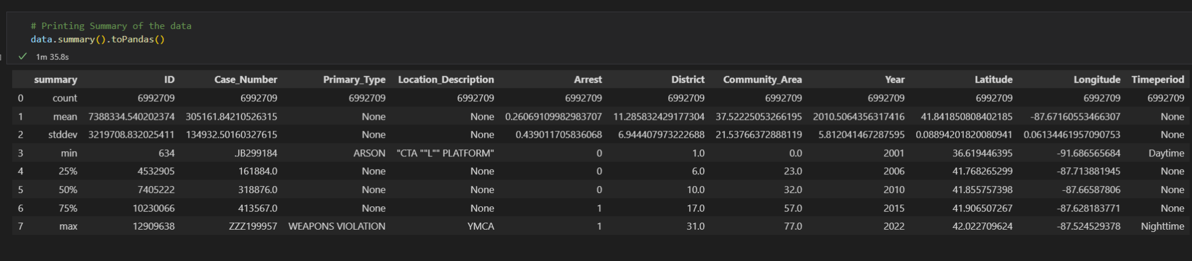
Data Overlook
About Dataset
Problem
Process
Method & Result
Conclusion

Slide 10
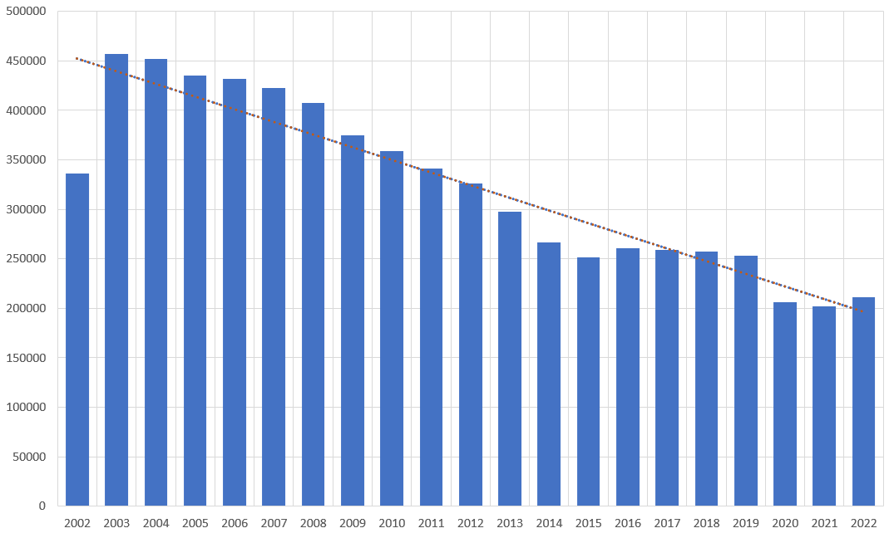
It seems that the number
of cases is decreasing.
Crime Cases Count over years
About Dataset
Problem
Process
Method & Result
Conclusion

Slide 11
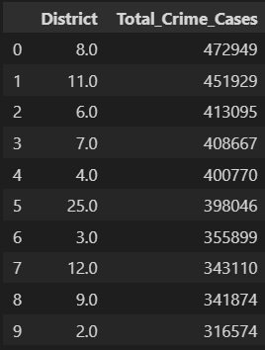
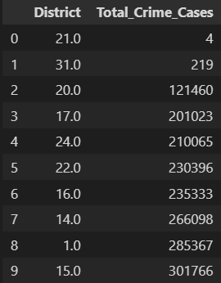
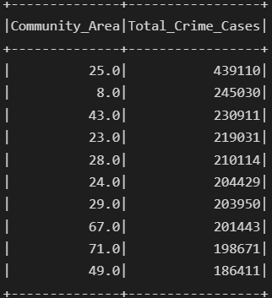
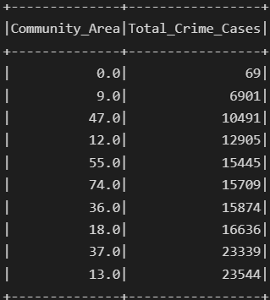
Ranking crime cases count
By Police District
By Community Area
About Dataset
Problem
Process
Method & Result
Conclusion

Slide 12
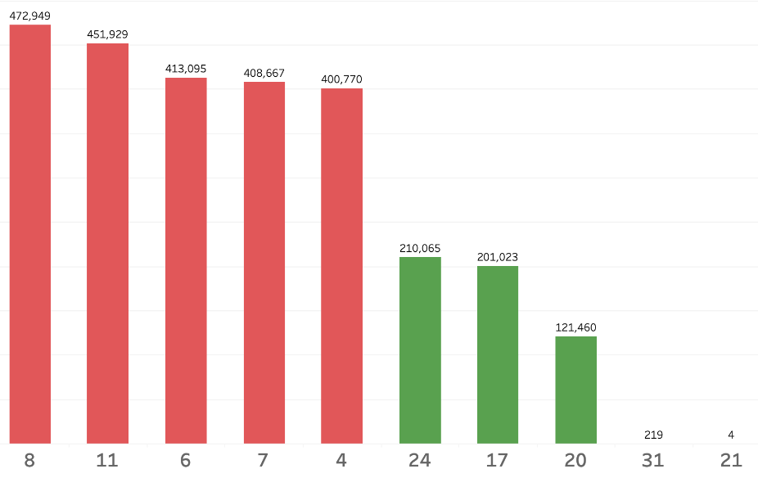
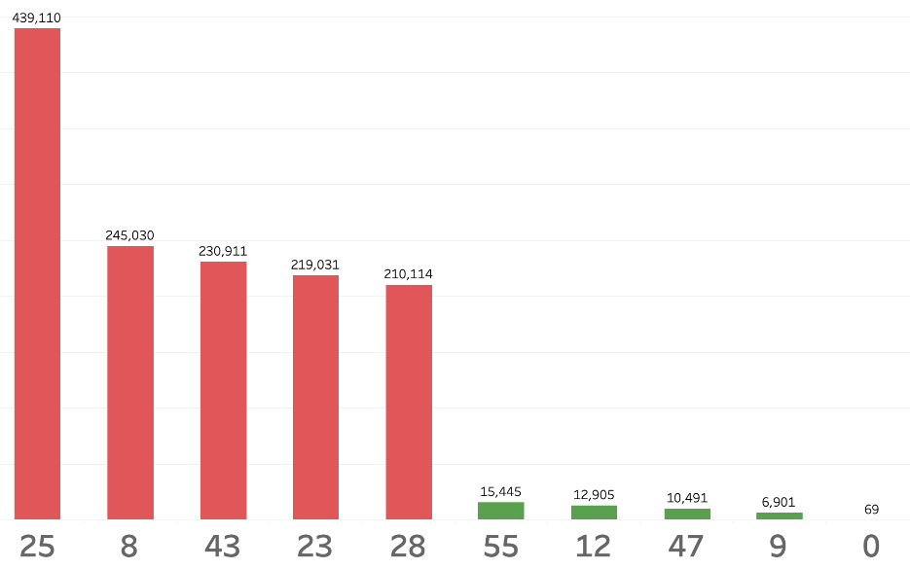
Ranking crime cases count
By Police District
By Community Area
About Dataset
Problem
Process
Method & Result
Conclusion

Slide 13
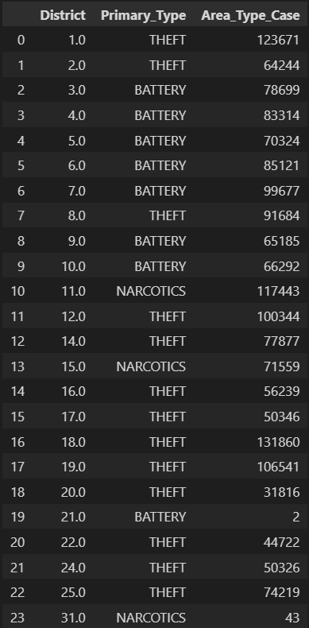
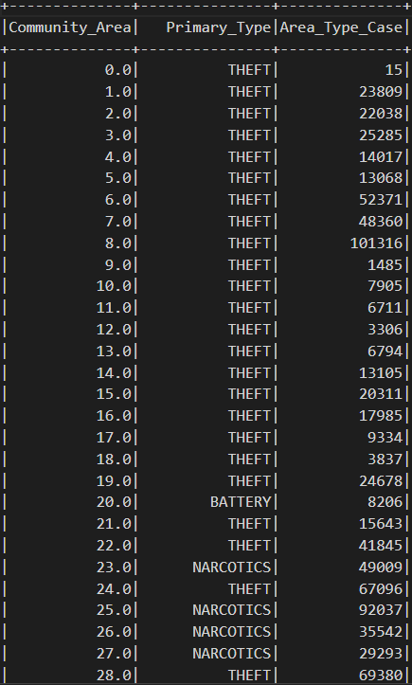
Ranking Crime Type
By Community Area
By Police District
About Dataset
Problem
Process
Method & Result
Conclusion

Slide 14
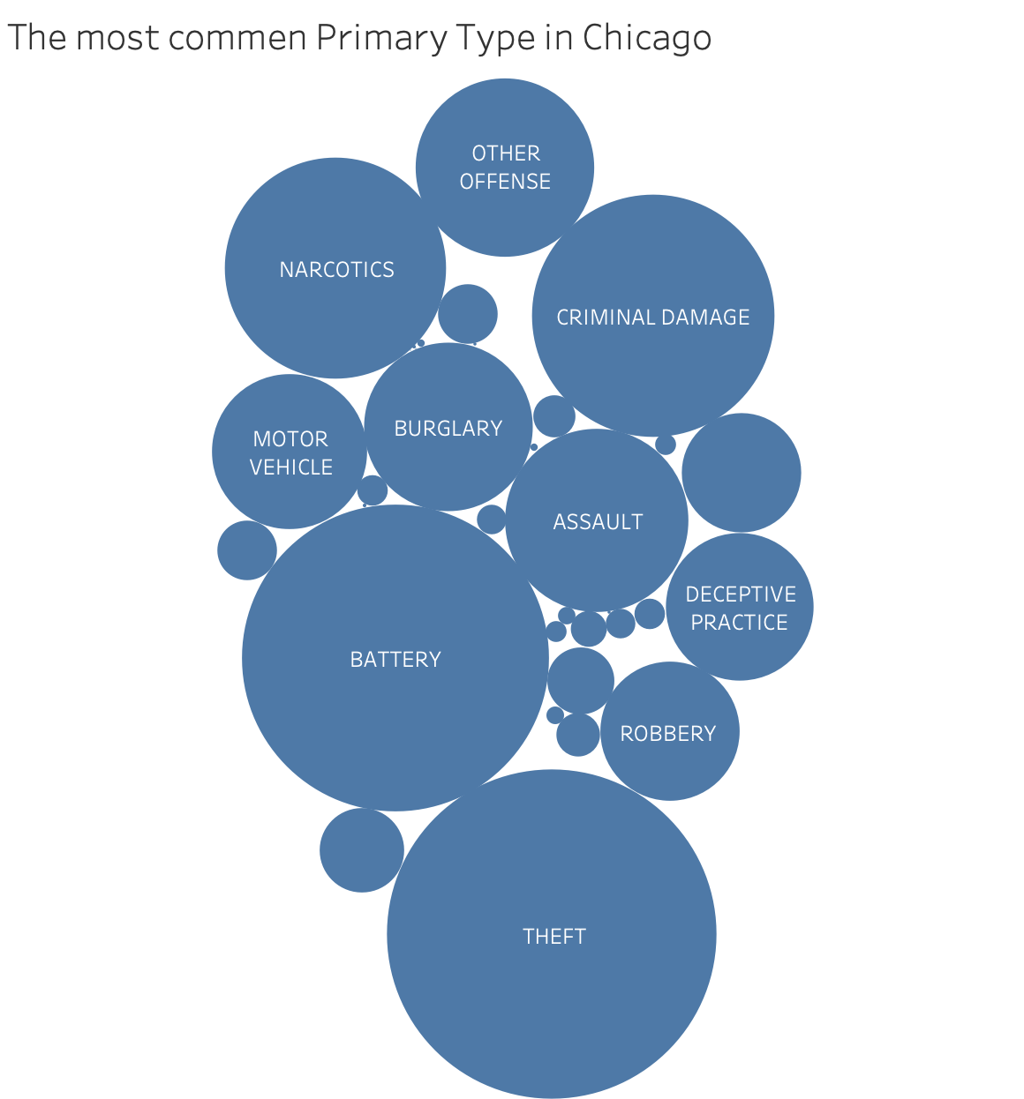
Top 5 Types of Crimes
Types | Number of Cases
Theft | 1480335
Battery | 1284641
Criminal Damage | 801293
Narcotics | 667185
Assault | 457934
…… | ……
About Dataset
Problem
Process
Method & Result
Conclusion

Slide 15
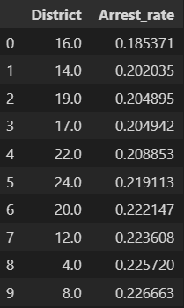
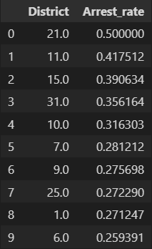
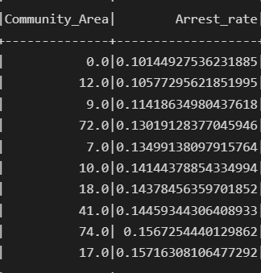
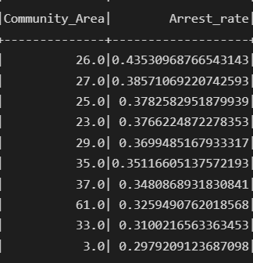
How about arrest rates(Arrested / Total)?
By Police District
By Community Area
About Dataset
Problem
Process
Method & Result
Conclusion

Slide 16
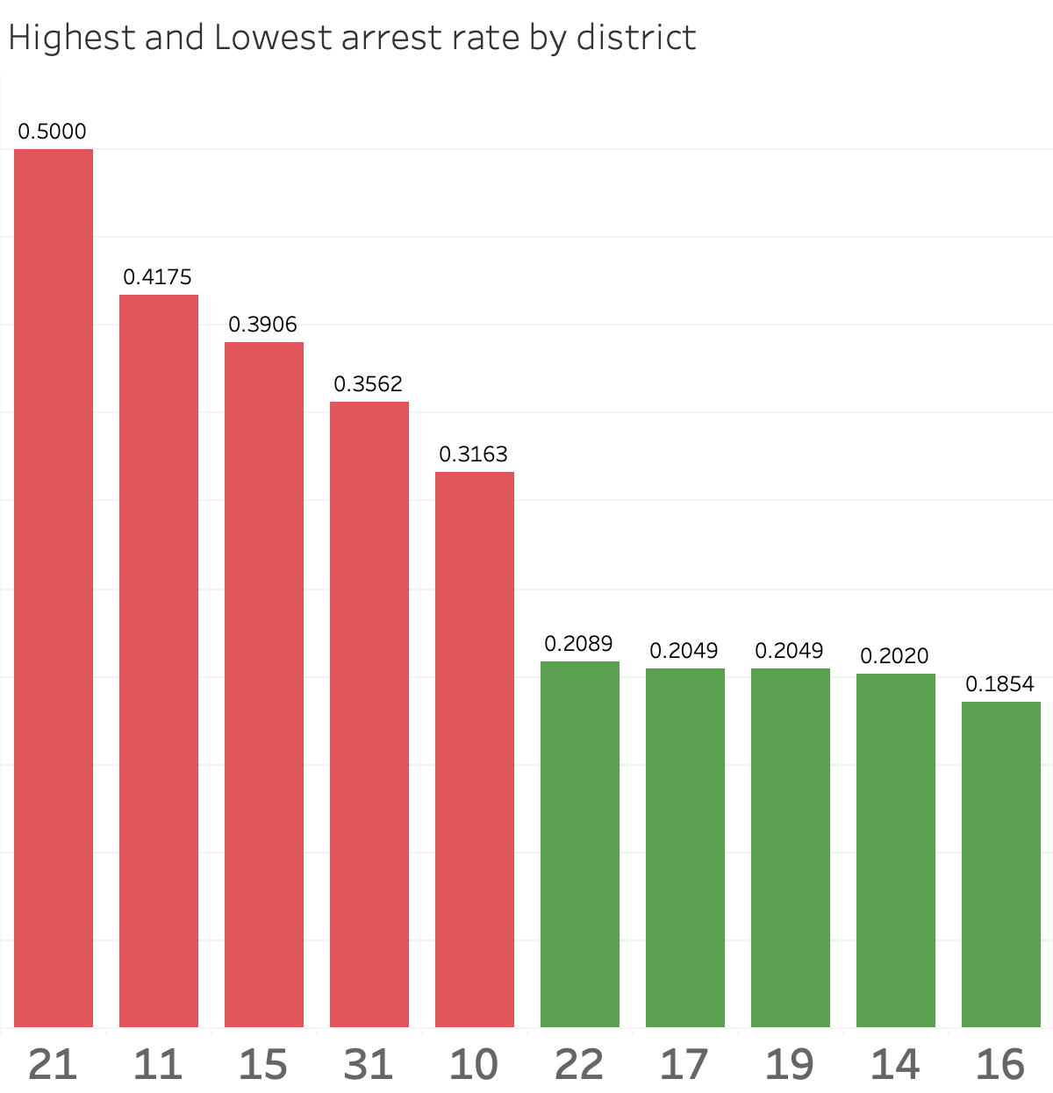
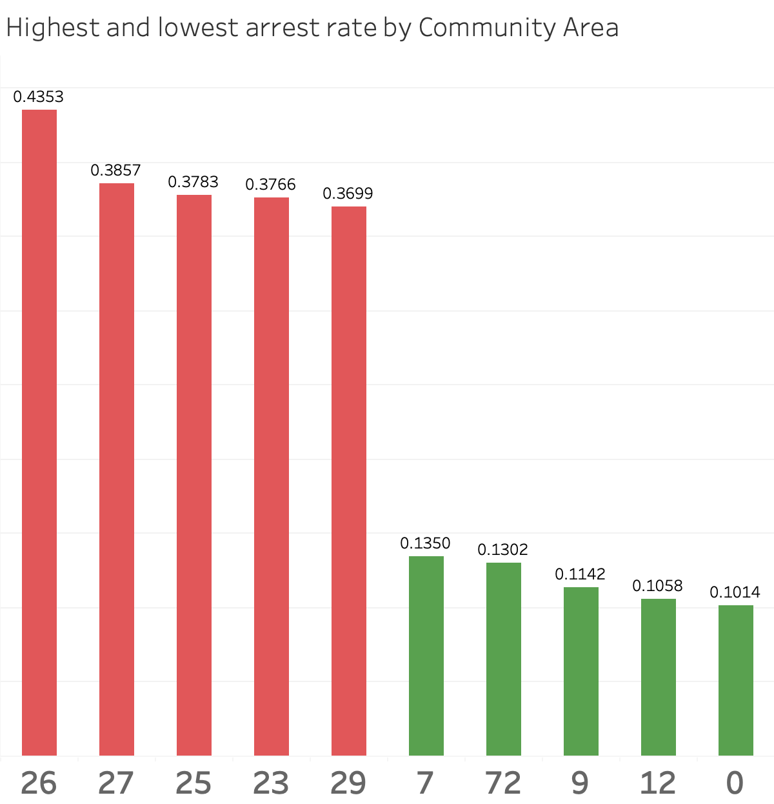
How about arrest rates(Arrested / Total)?
By Police District
By Community Area
About Dataset
Problem
Process
Method & Result
Conclusion

Slide 17
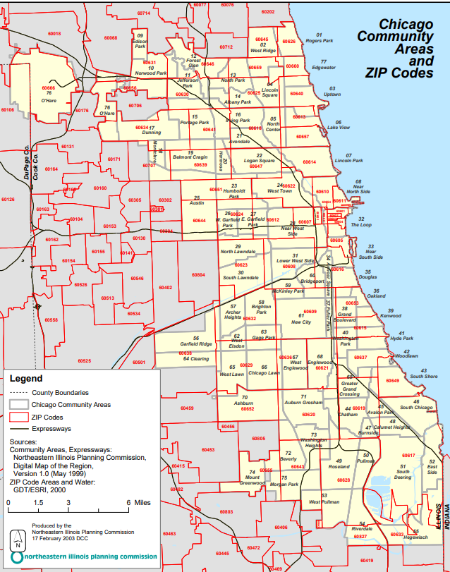
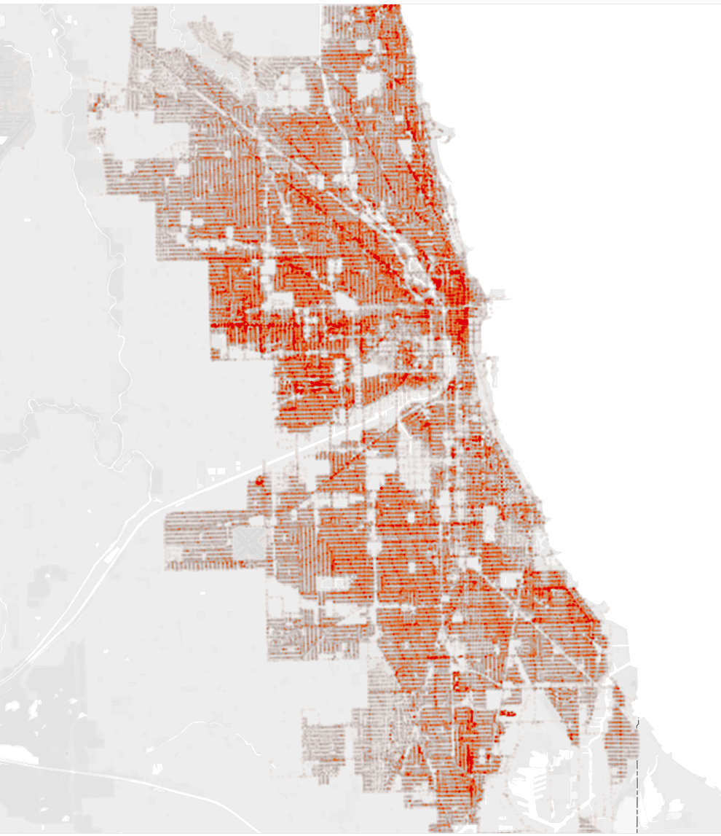
Heat
Map
About Dataset
Problem
Process
Method & Result
Conclusion

Slide 18
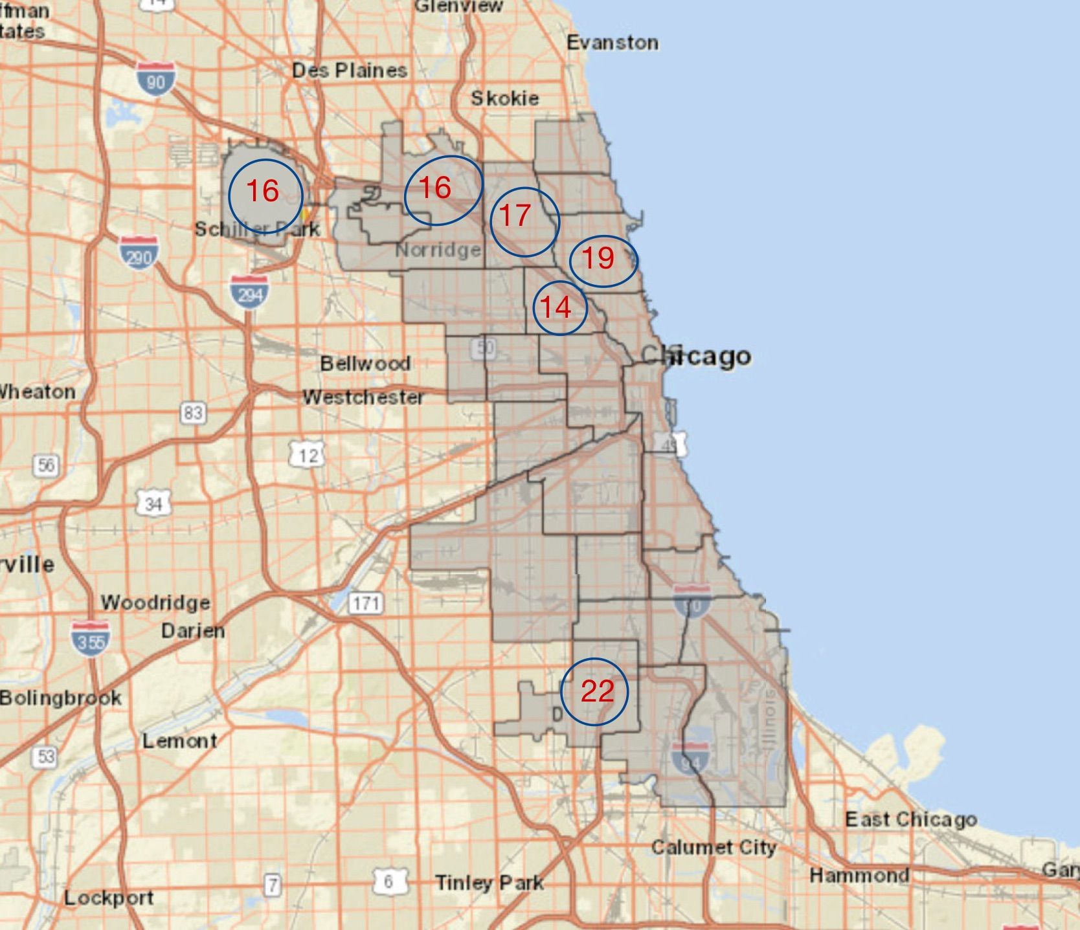
Conclusion
Recommendation: living zone(55: Hegewisch, 12: Forest Glen, 47: Burnside, 9: Edison Park)
Suggestion: area that police need to be enhance (22,17,19,14,16)
Find location through https://data.cityofchicago.org/Public-Safety/Boundaries-Police-Districts-current-/fthy-xz3r
About Dataset
Problem
Process
Method & Result
Conclusion

Slide 19
Further Improvements
01
02
03
Comprehensive data
Inspection System
Data Bias
About Dataset
Problem
Process
Method & Result
Conclusion

Slide 20
Thank you for your patience

